Slide 1


Daria Solodey
Methodist, course creator

Slide 2
Goal:
pass a job interview
Class rules:
Turn on your camera
Set up your microphone
Be active
Notes:
Если вам не хватило места, вы можете здесь написать развернутый комментарий.

Slide 3

Lesson Plan:
Practise answering the questions:
Why do you want to work here?
What is the most important to you in a job?
Notes:
Развернутый комментарий.

Slide 4
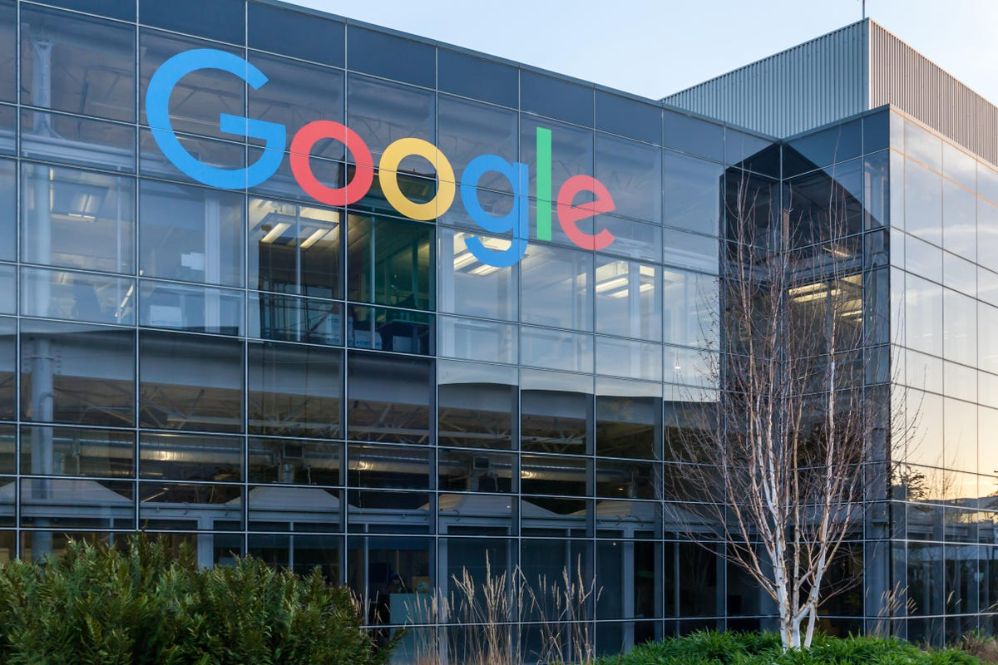
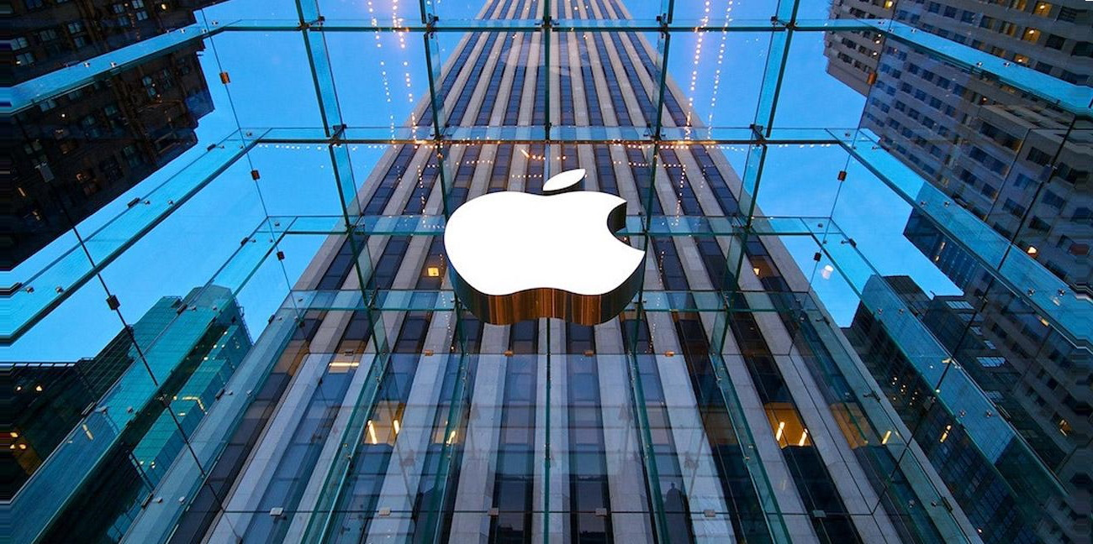

Which company would you like to work for? Why?
I would like to work for ….
BECAUSE....

Slide 5
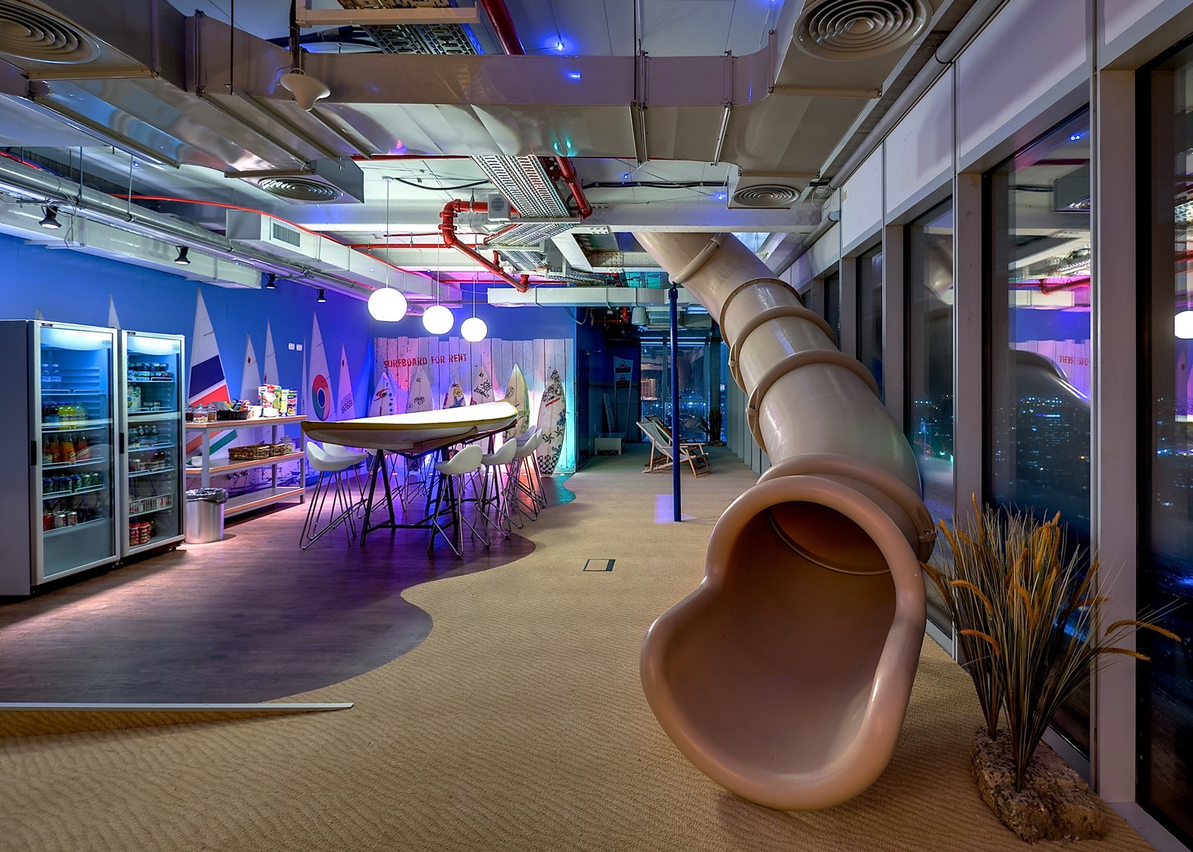
Look at the picture. Guess what place it is? What makes it different from an ordinary office?

Slide 6
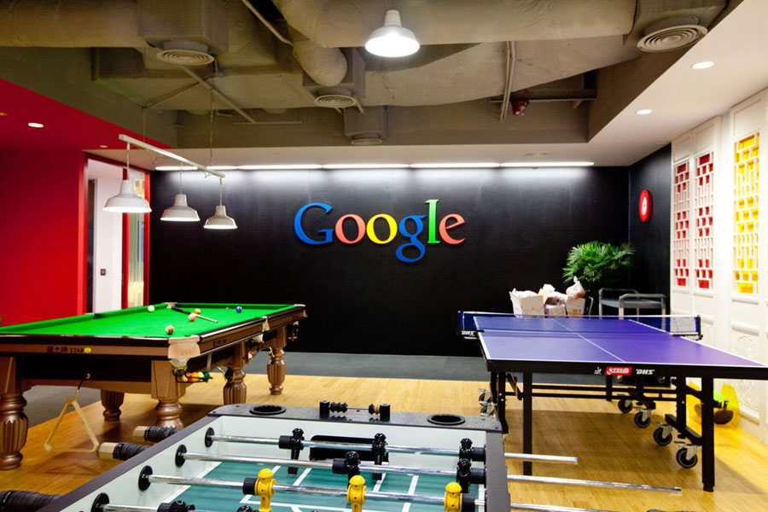
What do you know about Google?
Why do you think a lot of people want to work for Google?
Why (not)?

Slide 7

Why do people like working for Google?
What did the speaker mean when he/she mentioned the phrase…
At the forefront of technology?
Leapfrog innovation?
Preconceived notions?
To implement technologies?
To go beyond your skillset?
To have amazing expertise?

Slide 8
Answer the questions:
What other companies are at the forefront of technology nowadays? What made them such high-profile companies?
What is the latest leapfrog innovation? Why do you think so?
What preconceived notions are people in your country inclined to?
Are there any technologies implemented in 2021? Give some examples.
Are there any tasks in your homework that go beyond your skillset? How do you cope with them?
What should you do to have amazing expertise?

Slide 9
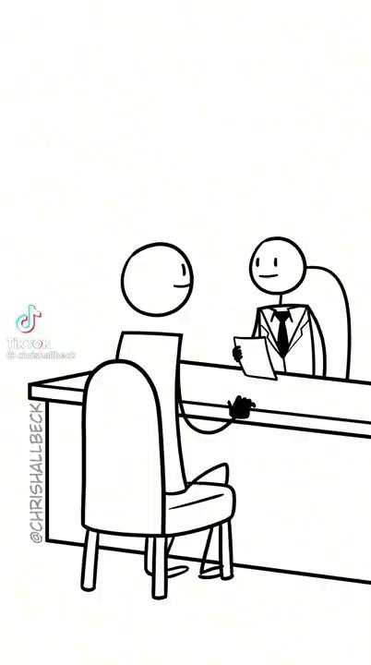
Interview question:
“Why do you want to work for our company?”
Is salary the most important part of a job? Why (not)?

Slide 10
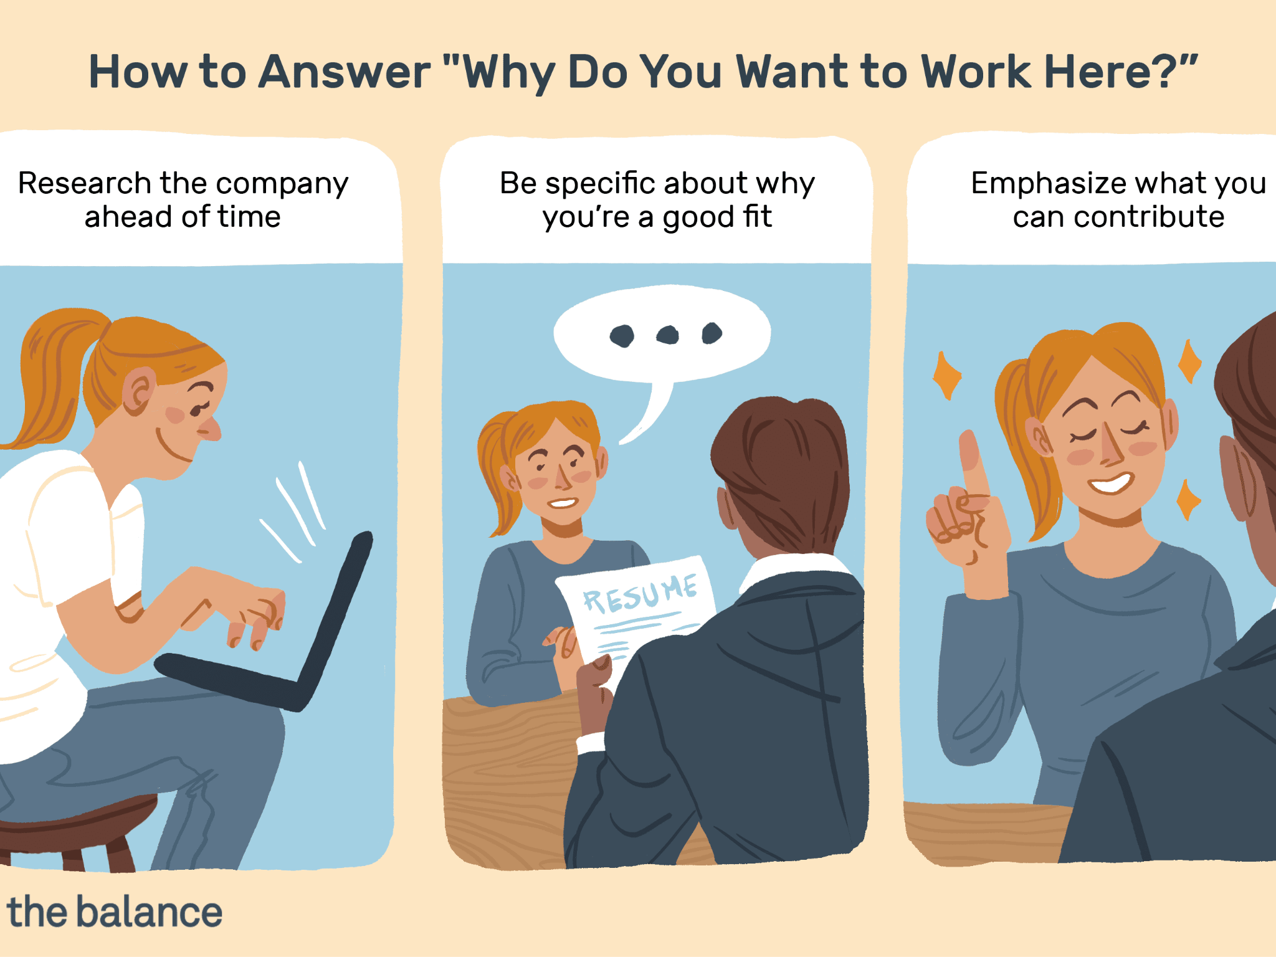
Look through the information.
Answer the question “Why do you want to work for Google?”
Example:
‘This company is world-renowned for the technology you create. In just the past year you have won a number of awards for your latest software.
I would love to bring my experience of developing new IT products to contribute to a team that is this resourceful, hardworking, and collaborative.’

Slide 11

Read the question. Why does an employer ask you this question?
What Is the Most Important to You at Work?

Slide 12
Read the question. Why does an employer ask you this question?
What Is the Most Important to You at Work?
Employers simply want to see what your priorities are and if you can put them into words

Slide 13
Research the values of your company. What values do you find similar to yours? Present them and explain your choice.
Google Microsoft
We want to work with great people
Don't take success for granted
Do the right thing; don't be evil.
Innovation
Corporate social responsibility
Environment
Apple
We believe in the simple, not the complex.
We participate only in markets where we can make a significant contribution.
We believe in saying no to thousands of projects so that we can focus on the few that are important and meaningful to us.
What is the most important to you at work?

Slide 14

What can you do after this lesson?
I learned:
How to answer the questions:
Why do you want to work here?
What is the most important to you in a job?
Notes:
Развернутый комментарий

Slide 15
Useful links:
Video:
What's it like to work at Google?
Words from this lesson:
Glossary 3

Slide 16
Thank you!

